Slide 1
MULTI-CUT REBAR(11)
Advisor : Prof. K.C.Chang
Presenters : You-Ran Nai
Notes:
試試看暫停一下

Slide 2
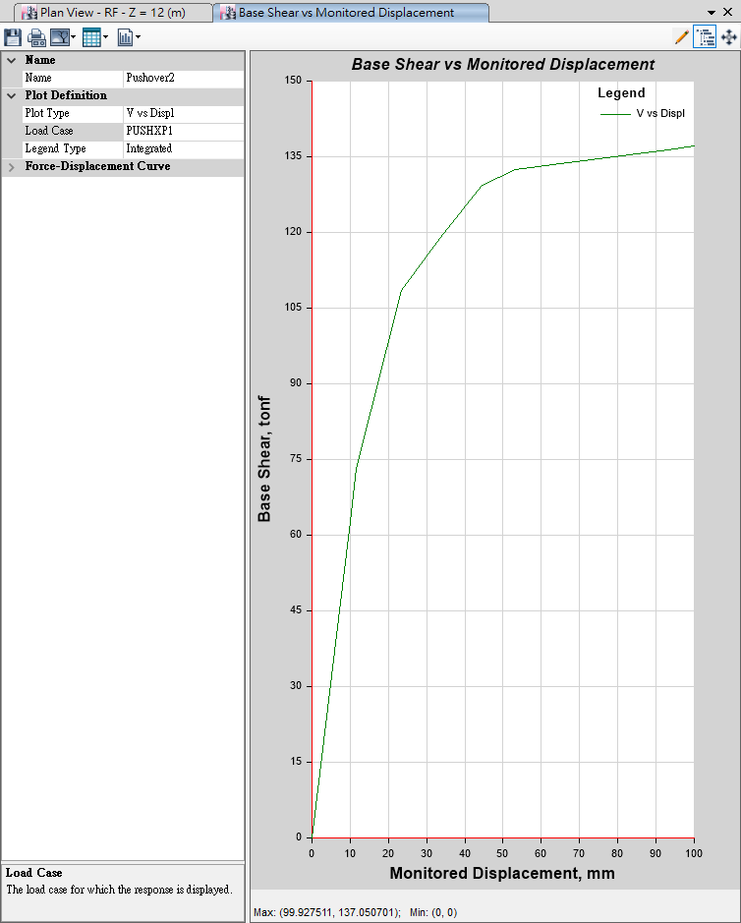
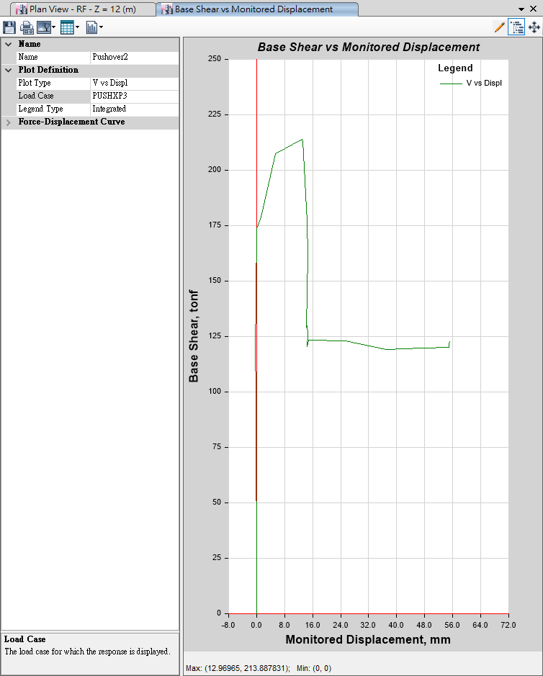
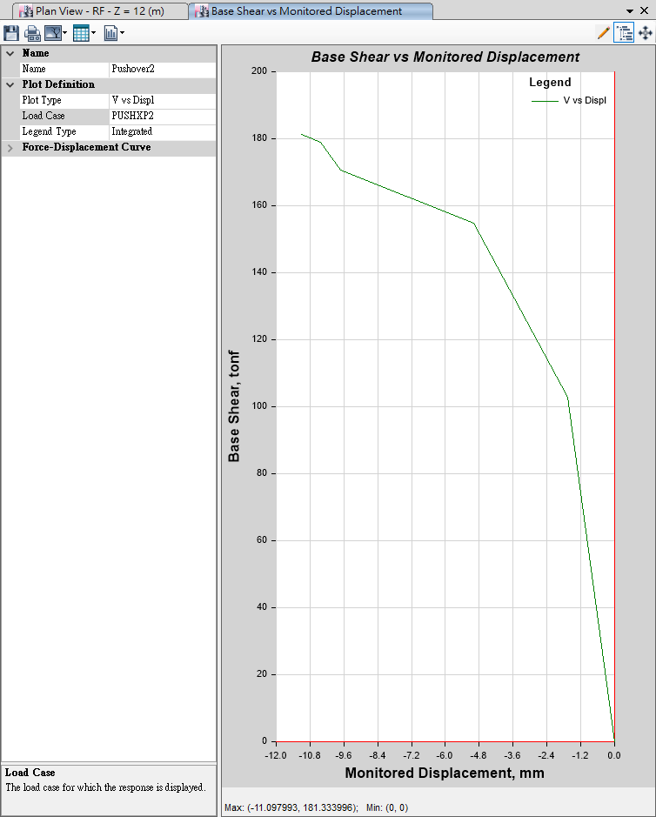
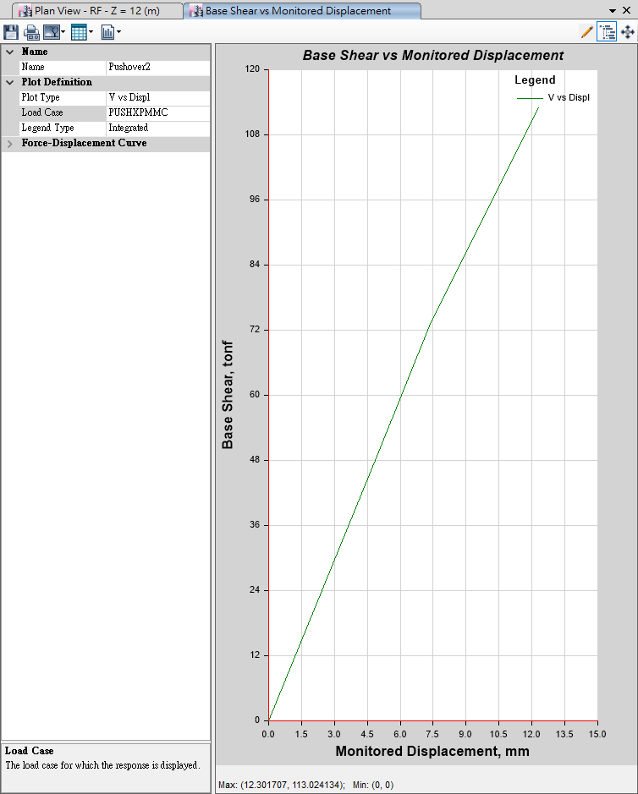
Pushover
Mode 1
Mode 3
100mm
10mm
Mode 2
MMC
10mm
10mm

Slide 3
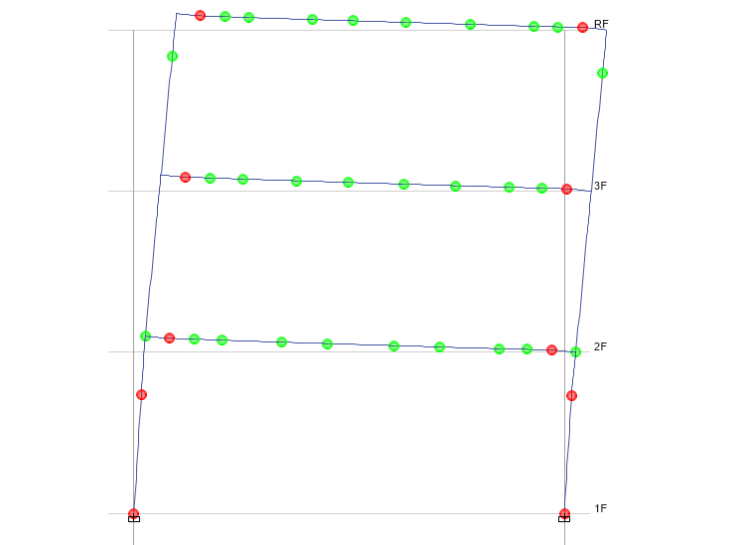
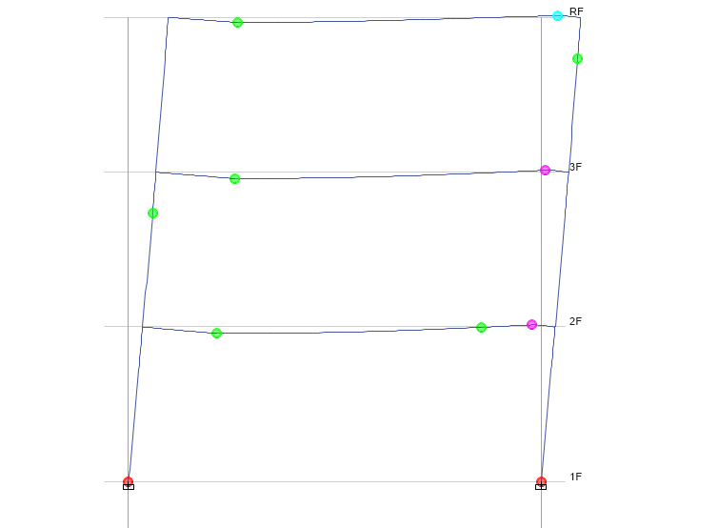
Time History
Pushover
No Middle Hinge

Slide 5
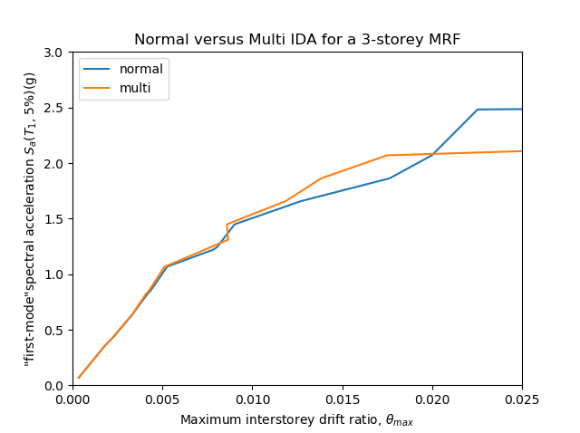
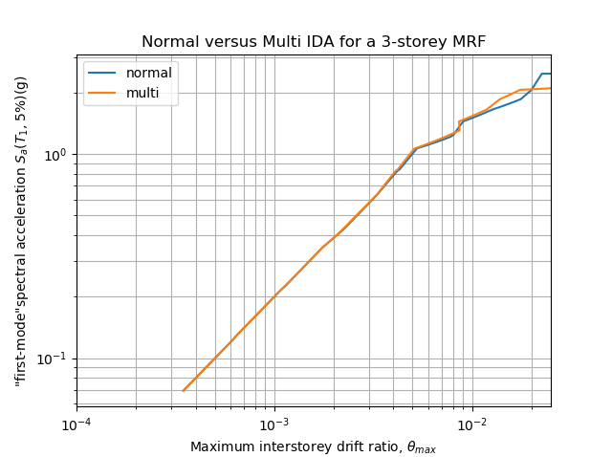
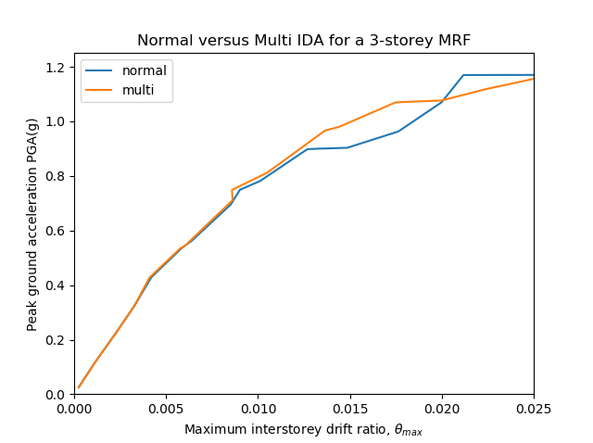
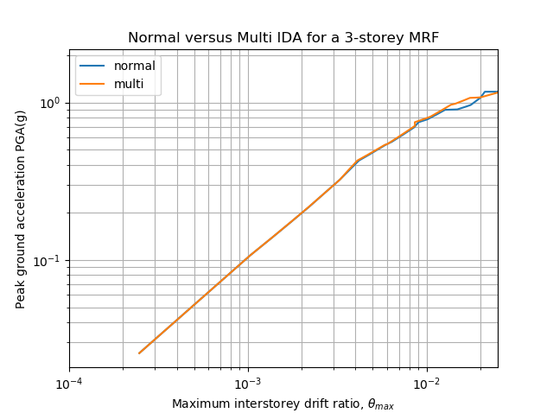
Sa(T₁, 5%)
PGA

Slide 6
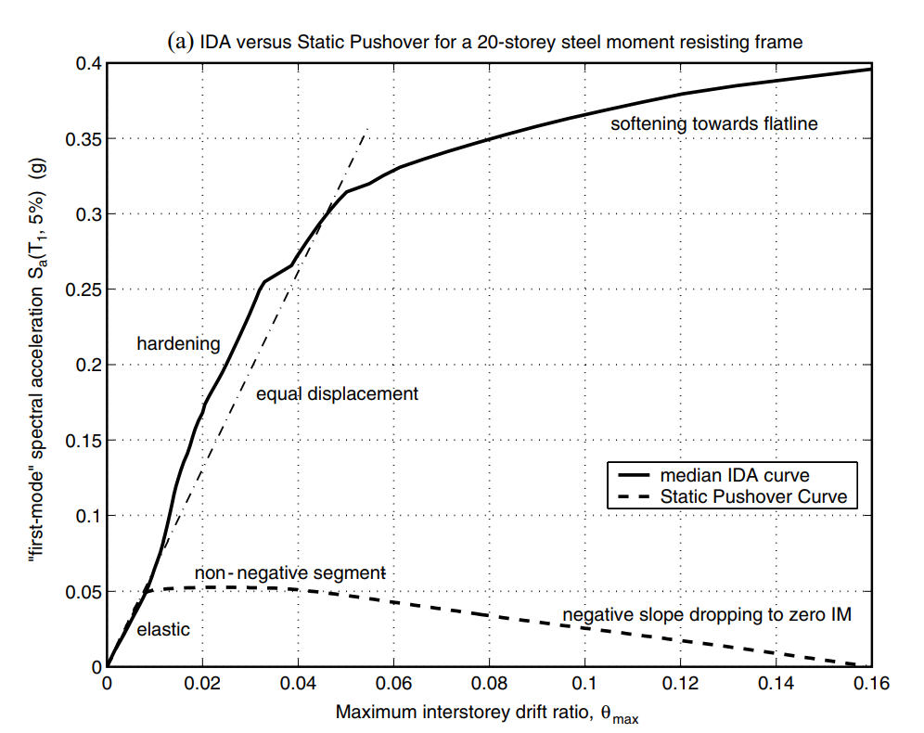
NON-LINEAR SPO
ELASTIC
➔
MATCH
NON-NEGATIVE
➔
EQUAL DISPLACEMENT
NEGATIVE
➔
SOFTENING

Slide 7
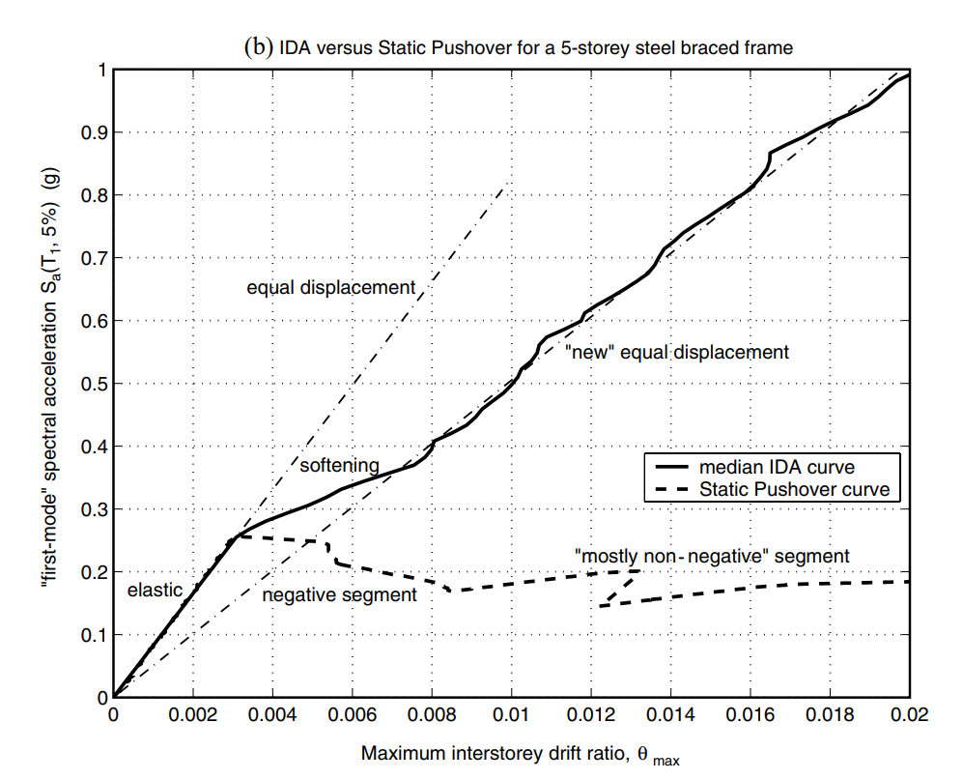
NON-LINEAR SPO
NEGATIVE => NON-NEGATIVE
NEW
EQUAL DISPLACEMENT
➔

Slide 8
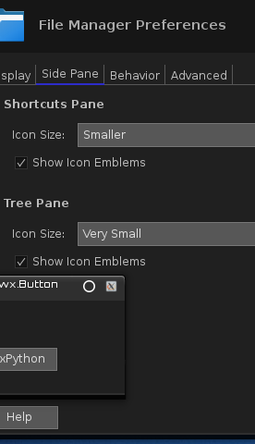
LinearCut GUI

Slide 9
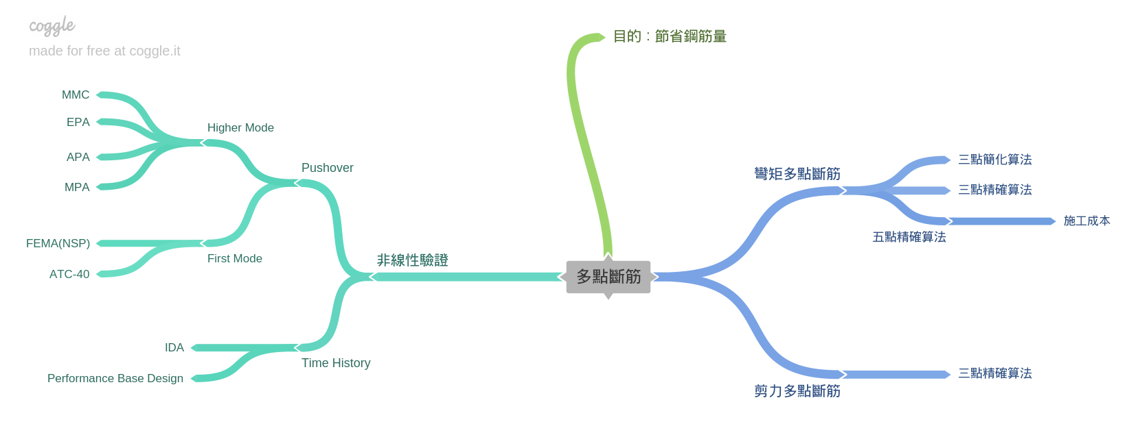
Roadmap
GUI
Nonlinear Hinge

